Slide 1
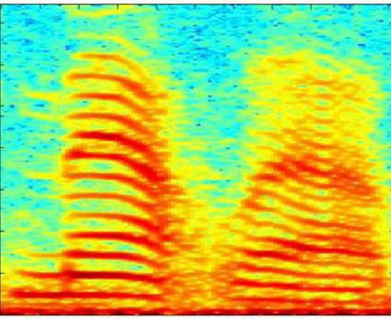
CNN Structure on STFT Spectrogram
STFT Spectrogram 분석을 위한 CNN 구조
Convolutional layer와 max-pooling layer를 순차적으로 적용
subsampling
convolution
subsampling
convolution
subsampling
Feature Extraction
NG : 81%
OK : 19%
Classification

Slide 2
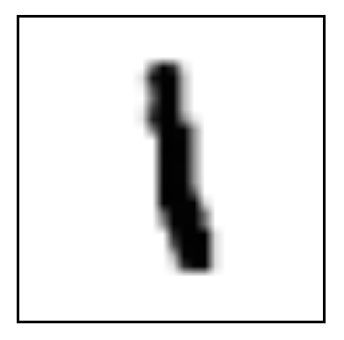
Input
28x28
Convolution
5x5
Subsampling
2x2
Convolution
5x5
Subsampling
2x2
Feature extraction
Classification

